Slide 1


Slide 2

Team 3 members
Paula Fiddi
Margot Tong
Clara Eleonore
Phoebe
Danlei

Slide 3
The Challenge
Currently they use the old fashioned method of papers for timesheet, voicemail messages to keep track of staff movements between seat locations.

Slide 4
Primary Objectives
To create an innovative application which would prompt Nurses and Carers to notify that they have left a session and have arrived home safely without having the need to telephone in.
An alert system which will alert the Nurse on Call/ Care Administration Team if a member of the Care Staff has not notified that they have left a session and arrived home safely.
Electronic timesheet and mileage tracker

Slide 5
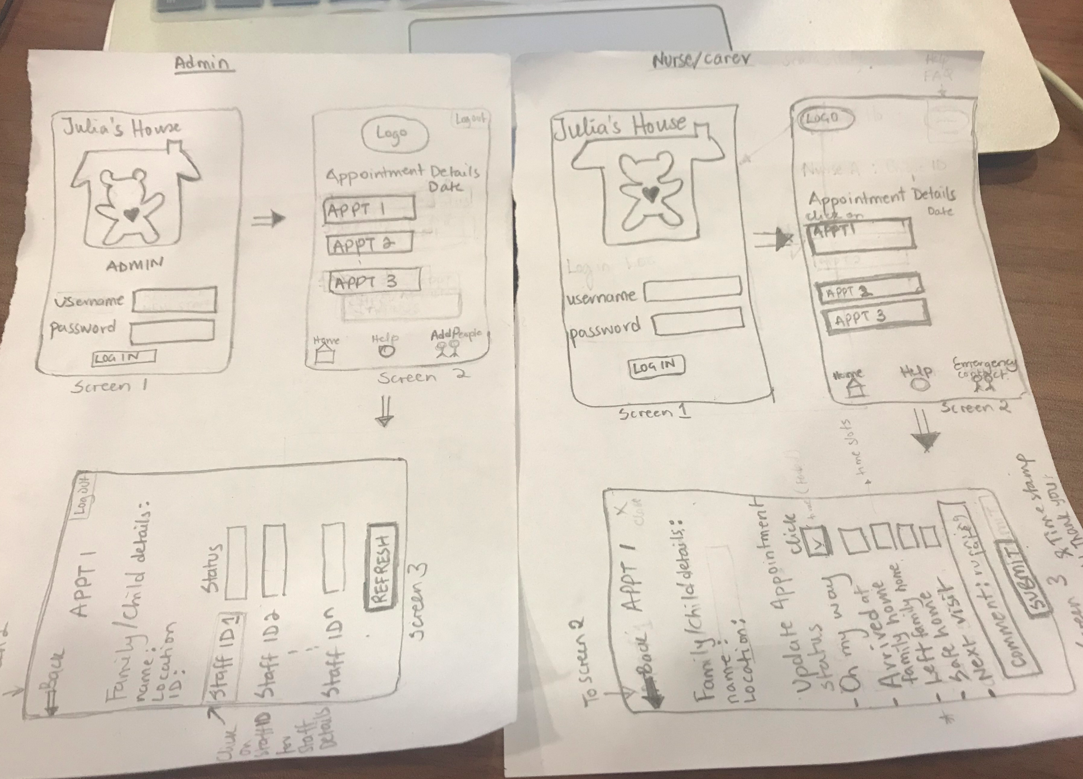
Our Approach/Strategy
User stories (Admin + Nurses & Carers)
Paper prototype
Task distribution

Slide 6



Julia’s House Staff App
Type of tech
Complexity
Features and
Functionalities

Slide 7
Demo...
GUI
Sample DB

Slide 8
Next Steps...
Scalability
Support & Maintenance

